Slide 1
REGENT UNIVERSITY DEPARTMENT OF COMPUTING MOBILE APP DEVELOPMENT PROJECT TOPIC DESIGN AND IMPLEMENTATION OF AN ANDROID APPLICATION FOR AN ONLNE FASHION SHOP
BY: GROUP 15
STEPHEN TENKORANG - 00870119
MORRIS NANA ACKON - 00400119
GitHub : https://github.com/monaac/SmartKart-App

Slide 2
IDEAS
PAYMENT OPTIONS/METHODS
SEARCH OPTIONS
SHOPPING CART
DELIVERY OPTIONS
GitHub : https://github.com/monaac/SmartKart-App

Slide 3
PROBLEM DEFINITION
Payment options/methods; these are but a few problems that our system aims to solve, Inaccessible merchant, Return instructions are hard to find, Preferred payment method not available and etc.
Search options; Customers or individual who are buying or browsing through our store sometimes find it hard to locate the exact products that they are looking for on our website.
Delivery options; Some delivery of goods take up to 7-10 working days, with very few options available to customers, incorrect orders being delivered, orders not being delivered at all, oversized and undersized clothes being delivered, and the driver requiring a lot of guidance to find the delivery location.
GitHub : https://github.com/monaac/SmartKart-App

Slide 4
PROBLEM SOLUTION
The trend in our age is the internet, almost everything we do on our day-to-day activities is on the internet. Now almost everyone single person with smartphone shops online and that is the reason why this project is most valid. Online shopping is a norm and these are a few problems our app aims to solve;
Payment options/methods, modern online payment services offer easy-to-use, fast and secure ways to pay for goods and services they acquire online. Some notables online payment methods that we’ll be using are; PayPal, mobile money, google pay, bank transfers and payment on delivery options which aims to gain enough trust and confidence from our customers as well as prospects.
Search engine will either built-in or integrated into the online store, and its job is to find the products the user is looking for by matching the user’s search keywords with the products in your store. Site search encompasses more than just the search box; it also refers to faceted search, product ranking, and synonym management. It filters your products based on user queries. All input is matched with product recommendations; be it product name, color, size or product code.
GitHub : https://github.com/monaac/SmartKart-App

Slide 5
PROBLEM SOLUTION
Shopping Cart; this software add-on will facilitates the purchase of a product or service. It accepts the customer's payment and organizes the distribution of that information to the merchant, payment processor and other parties. The online shopping cart is similar to the tangible ones we use at the supermarket, but it wears many more hats. It's also the shelves, the building, the clearance sign, the cash register and often the credit card machine relaying information back to the bank.
Delivery options; Our delivery software will boosts customer experience, ensures delivery profitability, drives same-day deliveries and helps brands gain end-to-end logistics visibility. This system will eliminate the problems that come with misplaced packages and customer complaints.
GitHub : https://github.com/monaac/SmartKart-App

Slide 6

Logo
GitHub : https://github.com/monaac/SmartKart-App

Slide 7
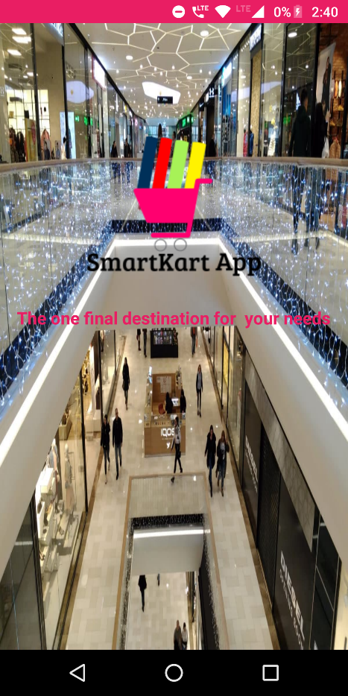
00.Welcome Screen
GitHub : https://github.com/monaac/SmartKart-App

Slide 8
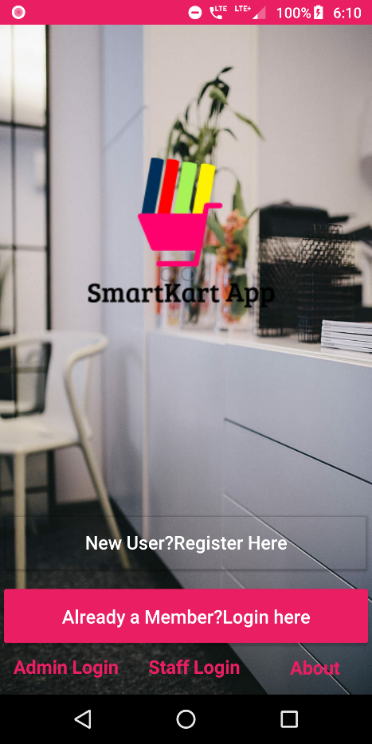
01.Home Screen
NEW USER REGISTER
ADMIN LOGIN
STAFF LOGIN
GitHub : https://github.com/monaac/SmartKart-App

Slide 9
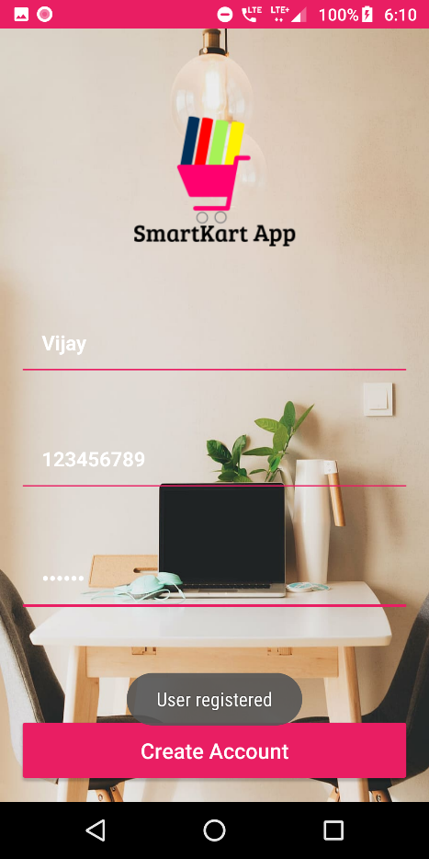
02.User Register
USER NAME
PHONE NUMER
PASSWORD
GitHub : https://github.com/monaac/SmartKart-App

Slide 10
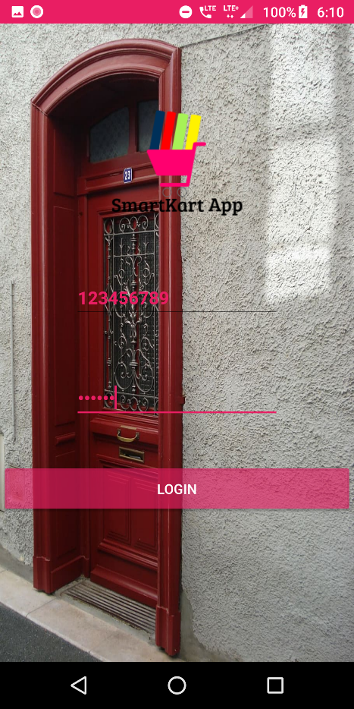
03.User Login
PHONE NUMER
PASSWORD
GitHub : https://github.com/monaac/SmartKart-App

Slide 11
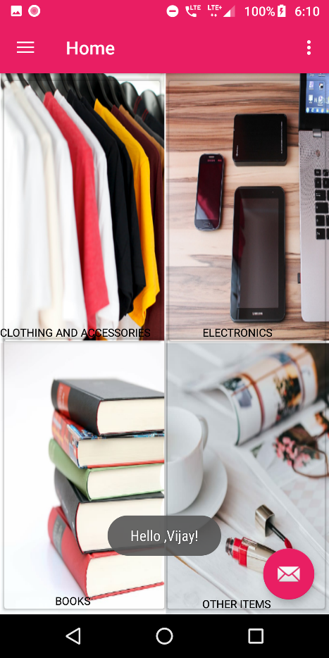
04.User Home Screen
CLOTHING & ASSESSORIES
ELECTRONICS
BOOKS
OTHER ITEMS
GitHub : https://github.com/monaac/SmartKart-App

Slide 12

05.A.Sub-Category selection
MEN’S CLOTHING & APPARELS
MEN’S CLOTHING & APPARELS
GitHub : https://github.com/monaac/SmartKart-App

Slide 13
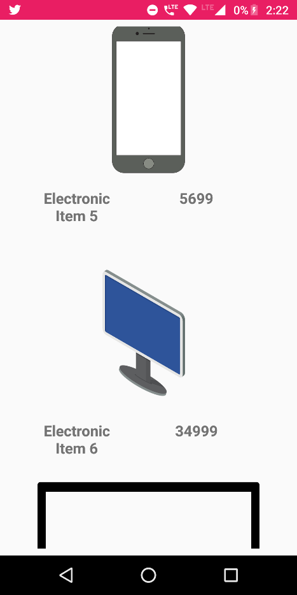
05.B.Recycler View of Items
ELECTRONIC ITEMS
GitHub : https://github.com/monaac/SmartKart-App

Slide 14
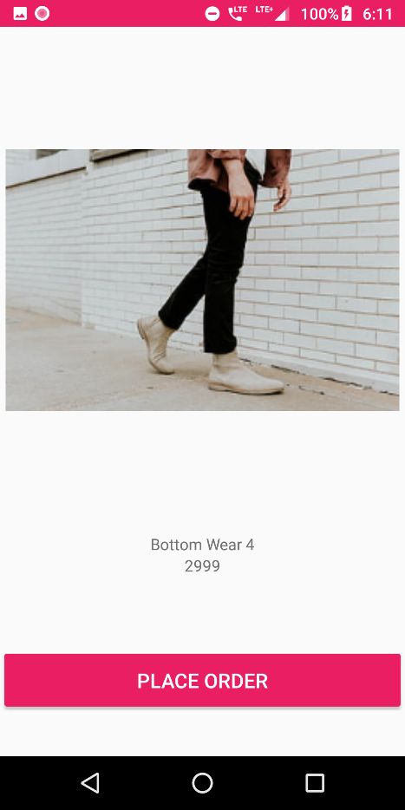
06.Item Display
CALL TO PLACE AN ORDER
GitHub : https://github.com/monaac/SmartKart-App

Slide 15
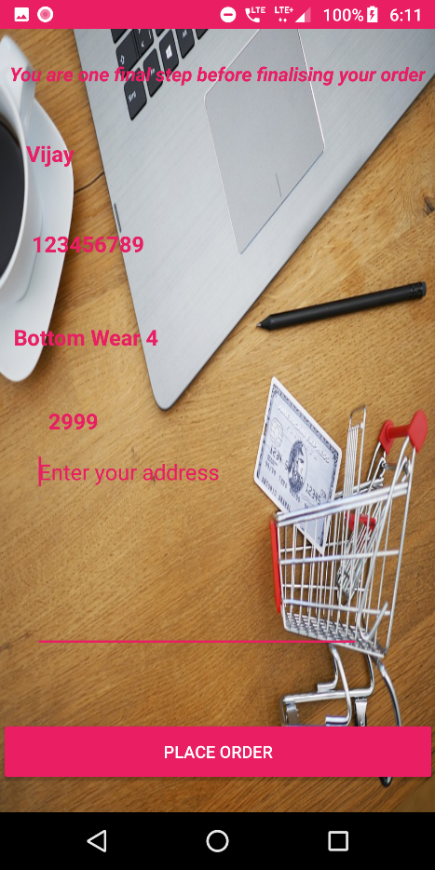
07.Place Order
ENTER ORDER DETAILS TO PLACE AN ORDER
GitHub : https://github.com/monaac/SmartKart-App

Slide 16
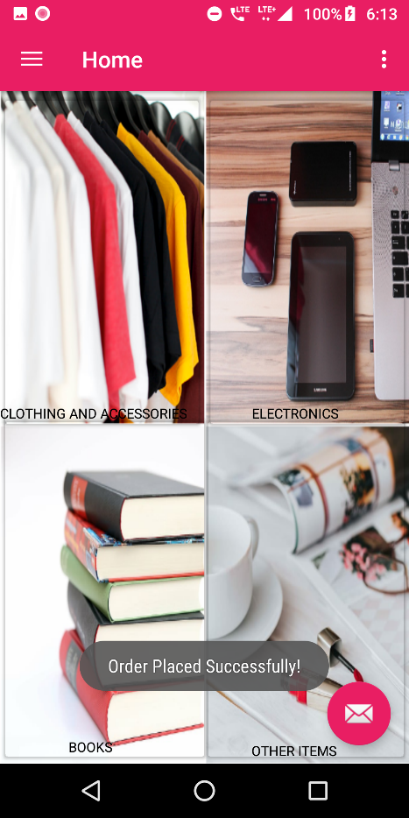
08.Success Message
SUCCESS ORDER DETAILS TO PLACE AN ORDER
GitHub : https://github.com/monaac/SmartKart-App

Slide 17
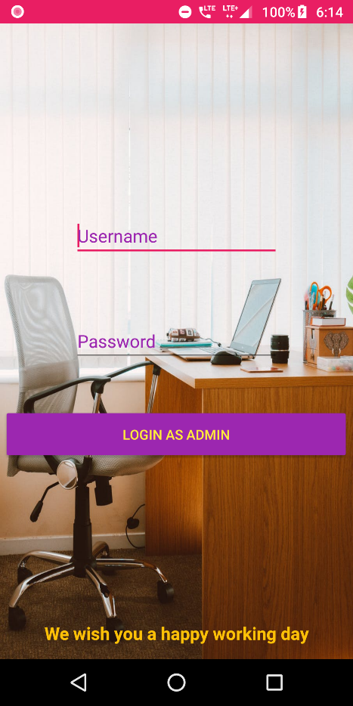
09.Admin Login
USER NAME
PASSWORD
GitHub : https://github.com/monaac/SmartKart-App

Slide 18
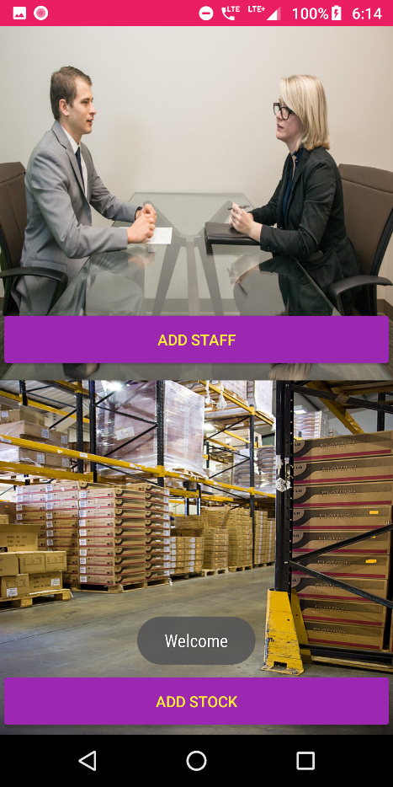
10.Admin Home Page
ADD STAFF USER
ADD STOCK
GitHub : https://github.com/monaac/SmartKart-App

Slide 19
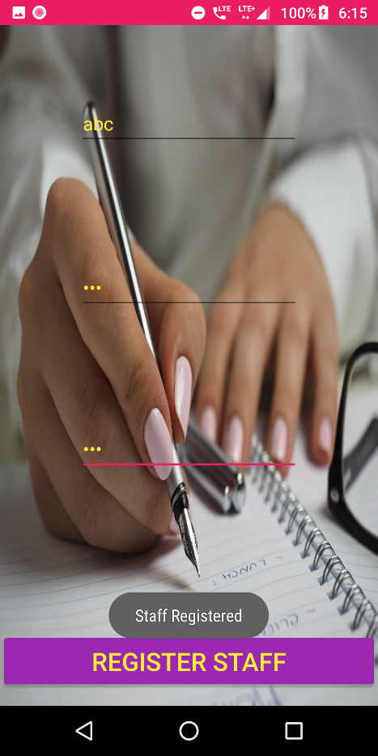
11.Staff Register
USER NAME
PASSWORD
GitHub : https://github.com/monaac/SmartKart-App

Slide 20
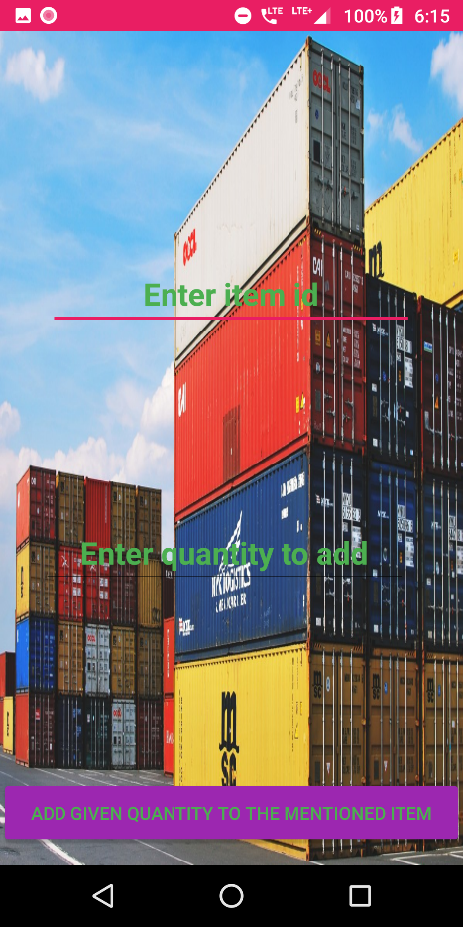
12.Add Stock
ITEM ID
QUANTITY

Slide 21
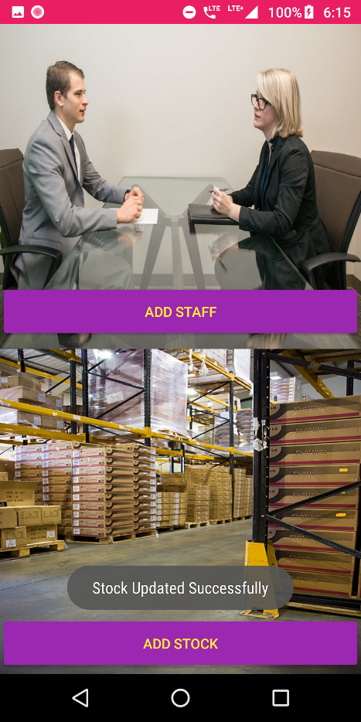
13.Success Message
SUCCESS IN ADDING STAFF

Slide 22
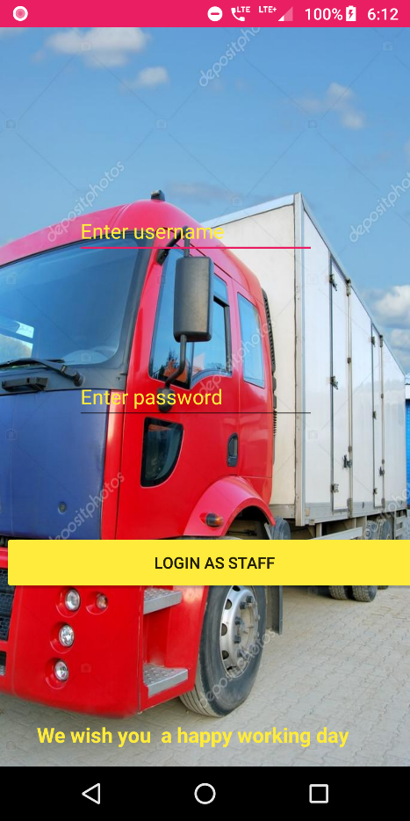
14.Staff Login
USER NAME
PASSWORD
GitHub : https://github.com/monaac/SmartKart-App

Slide 23
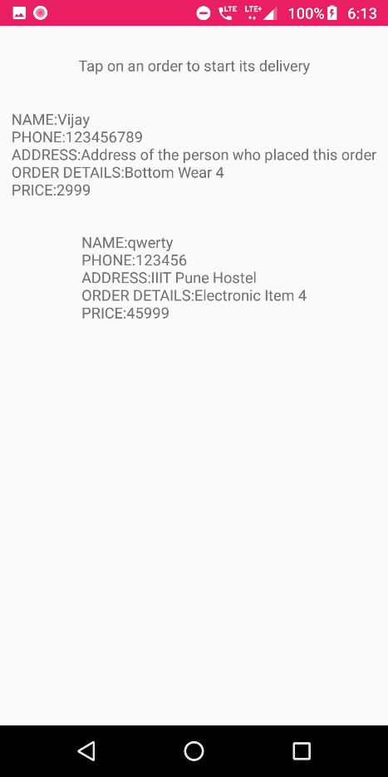
15.Select order to deliver
USER SELECTS AN ORDER FOR DELIVERY
GitHub : https://github.com/monaac/SmartKart-App

Slide 24
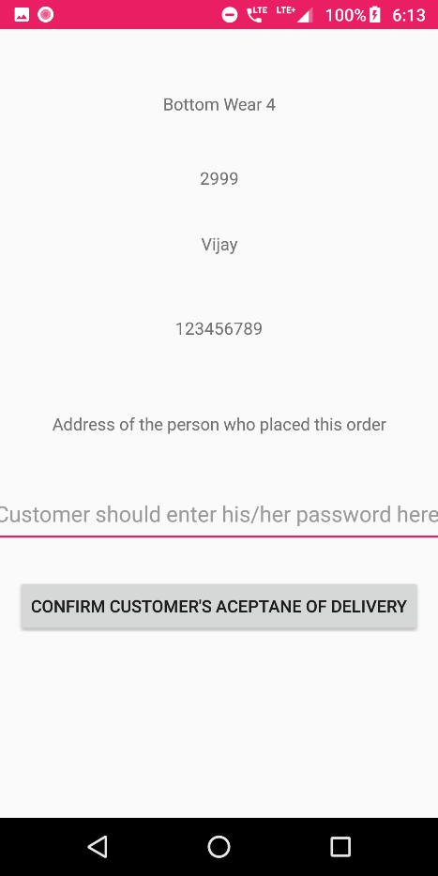
16.Confirm order delivery from customer
USER CONFIRMS AN ORDER FOR DELIVERY
GitHub : https://github.com/monaac/SmartKart-App

Slide 25

GitHub : https://github.com/monaac/SmartKart-App

Slide 26


THANK YOU
STEPHEN TENKORANG - 00870119
MORRIS NANA ACKON - 00400119

